Slide 1

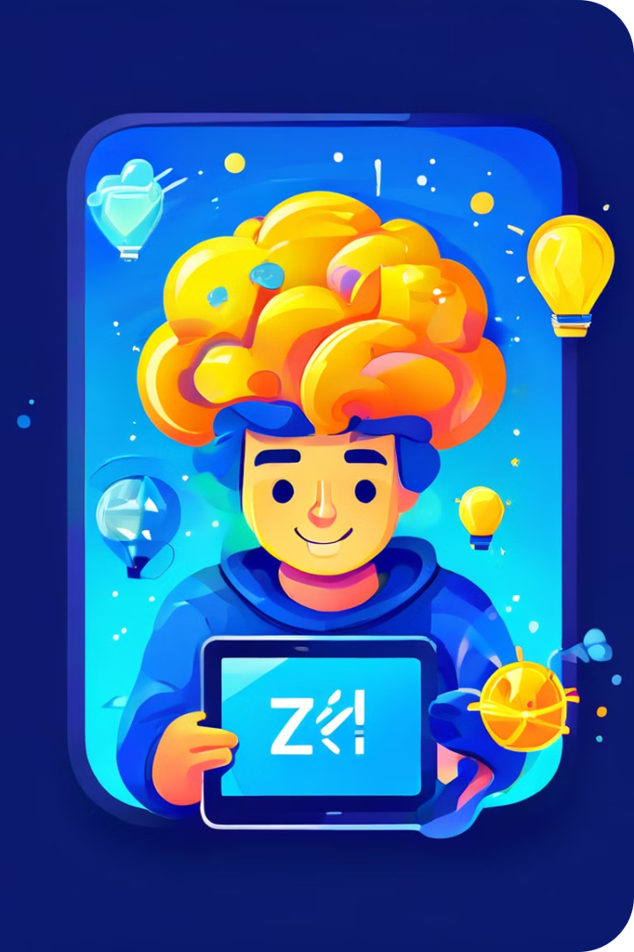
Game-Based Learning App for Skill Development
Introducing our innovative game-based learning app designed to help you master programming skills through interactive quizzes and challenges. Immerse yourself in a fun and engaging way to develop your coding expertise.
by Bhumika Murthy,
Utkarsh Bhardwaj

Slide 2
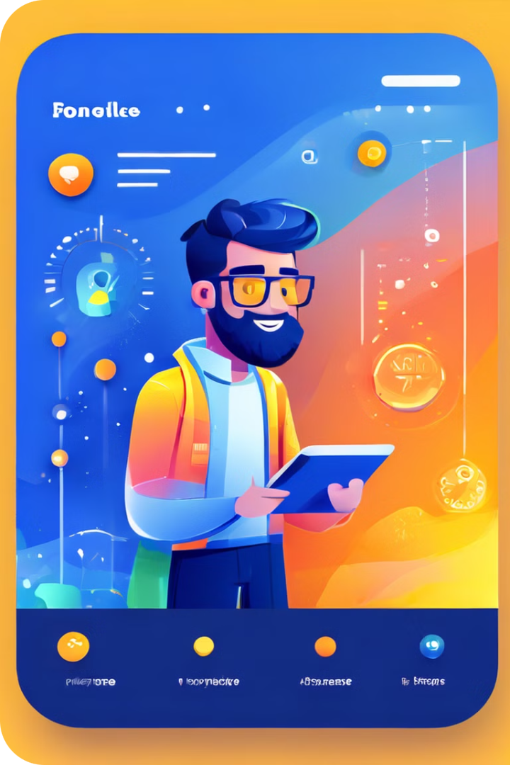
Introduction to the App
1
Adaptive Difficulty
2
Gamification Elements
The app adapts the quiz difficulty to your skill level, ensuring a personalized learning experience.
Earn points, badges, and climb the leaderboard to stay motivated and engaged.
3
Comprehensive Coverage
Covers a wide range of programming concepts, from beginner to advanced levels.

Slide 3
Key Features of the App
Personalized Quizzes
Interactive Lessons
Performance Insights
Tailored quizzes that challenge you based on your strengths and weaknesses.
Bite-sized video lessons and code examples to reinforce your learning.
Detailed analytics and reports to track your progress and identify areas for improvement.

Slide 4

Benefits of Game-Based Learning
Increased Motivation
Effective Retention
The engaging and competitive nature of the app keeps you motivated to learn and improve.
Game-based learning helps cement programming concepts through active participation and repetition.
Skill Development
Enjoyable Experience
Regularly practicing with the quizzes and challenges improves your programming abilities.
Learning becomes a fun, rewarding, and stress-free experience with the app.

Slide 5

Sample Quiz Questions and Gameplay
Syntax Challenges
Real-World Scenarios
Test your knowledge of programming language syntax and conventions.
Apply your programming skills to solve practical, industry-relevant problems.
1
2
3
Algorithm Puzzles
Solve coding challenges that test your problem-solving and logical thinking skills.

Slide 6





User Testimonials and Feedback
Improved Confidence
Enhanced Learning
The app has helped me become more confident in my programming abilities.
The interactive quizzes and lessons have made learning programming much more engaging.
Competitive Edge
Highly Recommended
Competing with friends and climbing the leaderboard has been a great motivator.
I would strongly recommend this app to anyone looking to improve their programming skills.

Slide 7




Ready to Level Up Your Programming Skills?
Download
Download the app from the app store or our website.
Start Learning
Dive into the interactive quizzes and challenges to begin your skill development journey.
Achieve Mastery
Continuously practice and track your progress to become a programming pro.

Slide 8

Thank You
Thank you for your interest in our game-based learning app. We hope this presentation has given you a glimpse into the exciting world of interactive programming skill development. Let's take your coding abilities to new heights together!

